Slide 1
Driving Supermarket Profitability:
“Analyzing Customer Behavior and Meal Pricing Strategies"

Slide 2
AGENDA
Introduction​
Project #1
Project #2
Project #3
​Conclusion

Slide 3
Introduction
Supermarkets play a crucial role in our daily lives by providing us with the necessary groceries and household items. The retail industry is constantly evolving with changing consumer demands, technological advancements, and economic fluctuations.
Therefore, it is imperative for supermarkets to optimize their operations to stay competitive, improve customer satisfaction, and maximize profits.

Slide 4







MEET OUR TEAM
Tehsin
Aesha
Gurjinder

Slide 5
Project #1
Data Visualization

Slide 6
Project #1
Project#1 is about exploration of the data to understand subsets of dataset, including:
Defining Problem Statement and Project Proposal
“Analyze sales revenue - pricing strategy and identify customer behavior”
Creating 9 different plots using the ggplot2 package in R that meet specific requirements
(displaying distributions, categorical variables, relationships between variables, and faceting)
Learn about the importance of data visualization in understanding a data set, in communicating important aspects of a data set
Role of integrity as an analyst in creating a data visualization for communicating results to others

Slide 7
Project #2
Data Cleaning and
Analyzing

Slide 8
Project #2
Project#2 is all about cleaning and analyzing the data, including:
Univariate Analysis
Identifying and handling outliers
Describing the shape of the data
Selecting appropriate measures of central tendency and spread
Computing correlation between variables
Bivariate Analysis
Visualize the relationship between pairs of variables
Describing the form, direction, and strength of the observed relationship
Explaining the relationship in the context of the data
Describing the variability observed in the plot and its correspondence with the strength of the relationship

Slide 9
Project #3
Data Modeling

Slide 10
Project #3
Project#3, Final Project is about data modeling, including:
Linear Regression Modeling
Assessing the linearity of the relationship between the explanatory and response variables
Understanding and interpreting the intercept and slope
Checking the usefulness of the intercept and slope
Model Diagnostic
Evaluating the goodness-of-fit of the model
Evaluating the residuals to ensure that there are no patterns or systematic errors in the model
Checking for the normality and constant variability of the residuals

Slide 11
Increasing Meal Price could be a viable strategy to increase revenue? what does this indicate about customer behavior?
Identify variables:
Explanatory variable: Meal Price
Response variable: Order Value
Equation:
Order_Value = β0 + β1Meal_Price
Where β0 is the intercept, and β1 is the coefficient for the independent variable Meal Price
Model Summary
Estimated value of the intercept is 246.22846 with a standard error of 5.64910
Coefficient of the Meal Price variable is positive (11.89778)
P-value for this coefficient is very small (<2.2e-16)
R-squared value (0.9507)
Slope coefficient is 11.89778

Slide 12
Understanding and interpreting the intercept and slope
Predicted value of Order Value when Meal Price is at its minimum or baseline level
It provides a starting point for the linear relationship between Meal Price and Order Value
The slope coefficient is 11.89778, implies that there is a positive and significant relationship between the Meal Price and the Order Value.
Checking the usefulness of the intercept and slope
The intercept does not have a meaningful interpretation in the context of our data
However, It does serve the purpose of providing the starting point for the regression line
As the Meal Price increases, the Order Value also increases, indicating that customers are willing to pay more for their meals

Slide 13
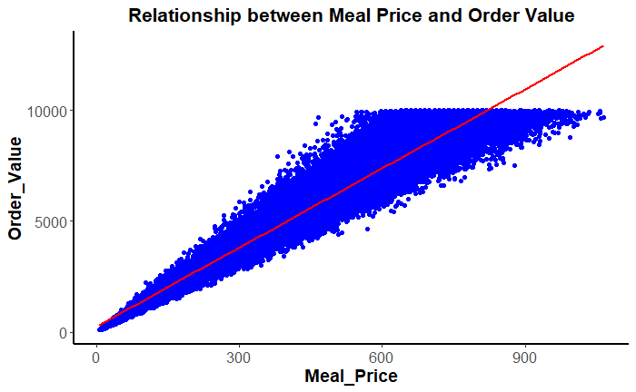
Model Diagnostic
Assumption of linearity?

Slide 14
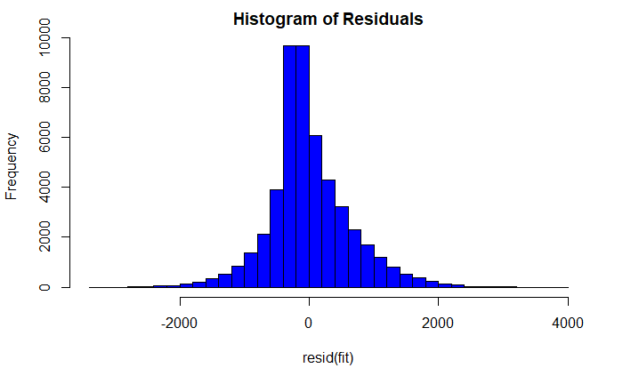
Model Diagnostic
Assumption of nearly normal residuals?

Slide 15
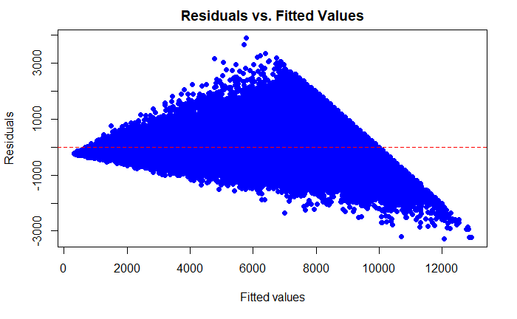
Model Diagnostic
Assumption of constant variability?

Slide 16

CONCLUSION
Based “Model Diagnostics” assumptions of,
Linearity
Nearly normal residuals
Constant variability
Model is a good fit for the data

